Slide 1
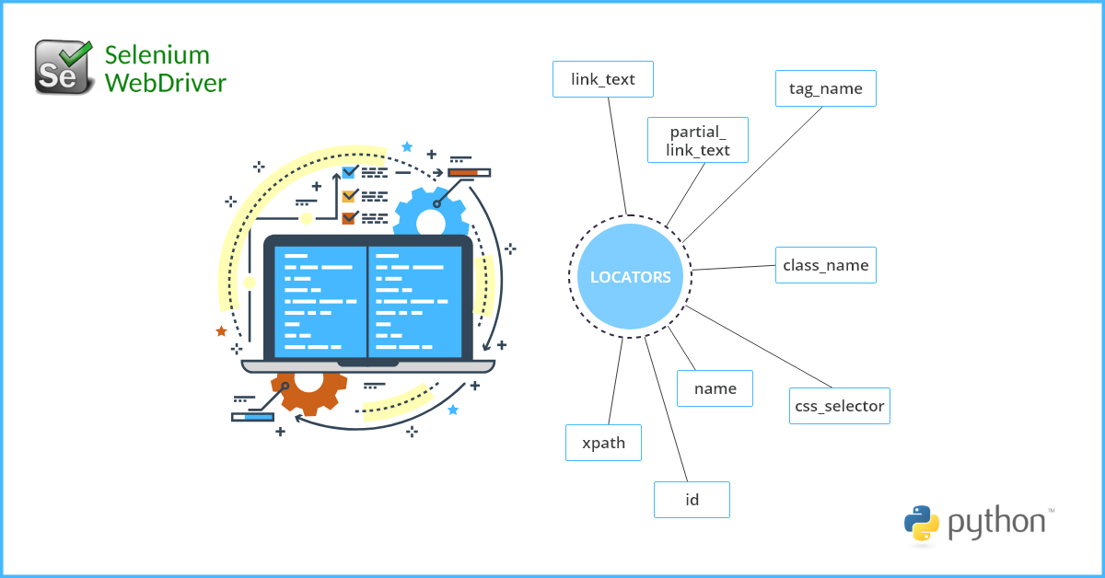
SQE PROJECT
Selenium
Automation Testing
Software Quality Engineering
TEAM MEMBERS
TEAM MEMBERS
M. TALHA FAROOQI
HUSNAIN ASLAM
F2022065010
F2022065361
2026

Slide 2
Project Objectives
Primary Goal
Testing Approaches
Design comprehensive manual test cases and then automate them for a real-world web application using two industry-standard approaches.
1
Selenium IDE
Record and playback automation for rapid test creation
Record
Playback
Assertions
Test Case Design
Automation
2
Python Selenium
Create structured manual test cases covering functional scenarios for comprehensive test coverage.
Implement automated test scripts using both Selenium IDE and Python Selenium in PyCharm.
Script-based automation for robust, maintainable tests
PyCharm
WebDriver
Python
Safety Constraint
All testing is performed without destructive actions or real transactions, ensuring safe evaluation of the application.
Both approaches ensure comprehensive coverage

Slide 3
Tools & Technologies
Selenium IDE
PyCharm IDE
Record & Playback
Python Scripts
Browser extension for rapid test creation through recording and playback of user interactions.
Professional Python IDE for developing robust, maintainable automated test scripts.
Click Recording
Assertion Creation
Test Export
Code Completion
Debugging
Version Control
Firefox
GeckoDriver
Python
OBS Studio
Browser for test execution
Browser automation driver
Programming language
Evidence documentation
Windows: Test execution platform
macOS: Development and testing environment

Slide 4
Environment Setup
Cross-Platform Setup
macOS and Windows environments configured successfully
To perform automated testing using both Selenium IDE and Python Selenium, the testing environment was set up on macOS and Windows. All required tools and dependencies were installed and verified successfully before test execution.
Python Installation (macOS)
Selenium Installation
Python was installed on macOS using Homebrew package manager.
Selenium Python library was installed using pip package manager.
$ brew install python
$ python3 --version
$ pip install selenium
$ pip show selenium
Installation verified through terminal
Selenium bindings verified
Package Manager: Homebrew (macOS)
IDE: PyCharm Professional

Slide 5
Selected Application
Amazon
Why Amazon Was Selected
E-commerce Platform
https://www.amazon.com
1
Widely Used Platform
Amazon is a globally recognized e-commerce platform with billions of users, making it an ideal real-world testing scenario.
2
Multiple Testable Modules
Provides diverse functional modules including search, cart, filters, and navigation for comprehensive testing.
Safety Compliance
3
Complex Interactions
Dynamic content and modern web features provide realistic challenges for automation techniques.
Amazon is suitable for automation without performing real purchases, aligning perfectly with assignment rules and ensuring safe testing practices.

Slide 6
Test Scenarios Overview
Total Test Cases
7
01
Verify Amazon Homepage Loads
02
Verify Product Search with Valid Keyword
Test that the Amazon homepage loads successfully with all key elements visible including logo and search bar.
Test product search functionality using a valid keyword (e.g., "MacBook Pro") to ensure relevant results are displayed.
03
Verify Search with Invalid Keyword
04
Verify Product Category Selection
Test search behavior with invalid keywords (e.g., "asdkjh12345") to verify proper error handling.
Test category dropdown functionality by selecting "Books" to filter results appropriately.
05
Verify Product Details Page Opens
06
Verify Add to Cart Functionality
Test navigation to product details page and verify key information (title, price, description) is displayed.
Test adding items to shopping cart and verify successful addition without proceeding to checkout.
07
Verify Remove from Cart Functionality
Test removing items from shopping cart and verify cart updates correctly.

Slide 7
Manual Test Cases
TC-01
Homepage
TC-02
Search
TC-03
Invalid
Test Case ID
Test Case ID
Test Case ID
TC_HomePageLoad_01
TC_ProductSearch_02
TC_InvalidSearch_03
Scenario: Verify Amazon homepage loads successfully
Scenario: Search product using valid keyword
Scenario: Search product using invalid keyword
Preconditions
Test Steps
Test Steps
Internet connection available, browser installed
1. Enter "MacBook Pro"
2. Click Search
1. Enter "asdkjh12345"
2. Click Search
TC-04
Category
TC-05
Details
TC_CategorySelection_04
TC_ProductDetail_05
Scenario: Select category from dropdown
Scenario: Open product details page
Steps: 1. Select "Books"
2. Click Search
Steps: 1. Click on any product from search results
TC-06
Cart
TC-07
Cart
Scenario: Add product to cart → Expected: Product added to cart successfully
Scenario: Add product to cart → Remove from art Expected: Product added to cart successfully

Slide 8
Automation Using Selenium IDE
Selenium IDE
Recorded Interactions
The above test cases were automated using Selenium IDE with comprehensive features for reliable test execution.
Click Operations
Text Input
Dropdown Selection
Navigation
Browser Launch & Close
Recorded User Interactions
Assertion Types
Multiple Assertion Types
Page Title
Element Presence
Text Verification
Verify correct page loaded
Verify elements visible
Verify expected text
Proper Command Usage
open
click
type
assertTitle
assertText

Slide 9
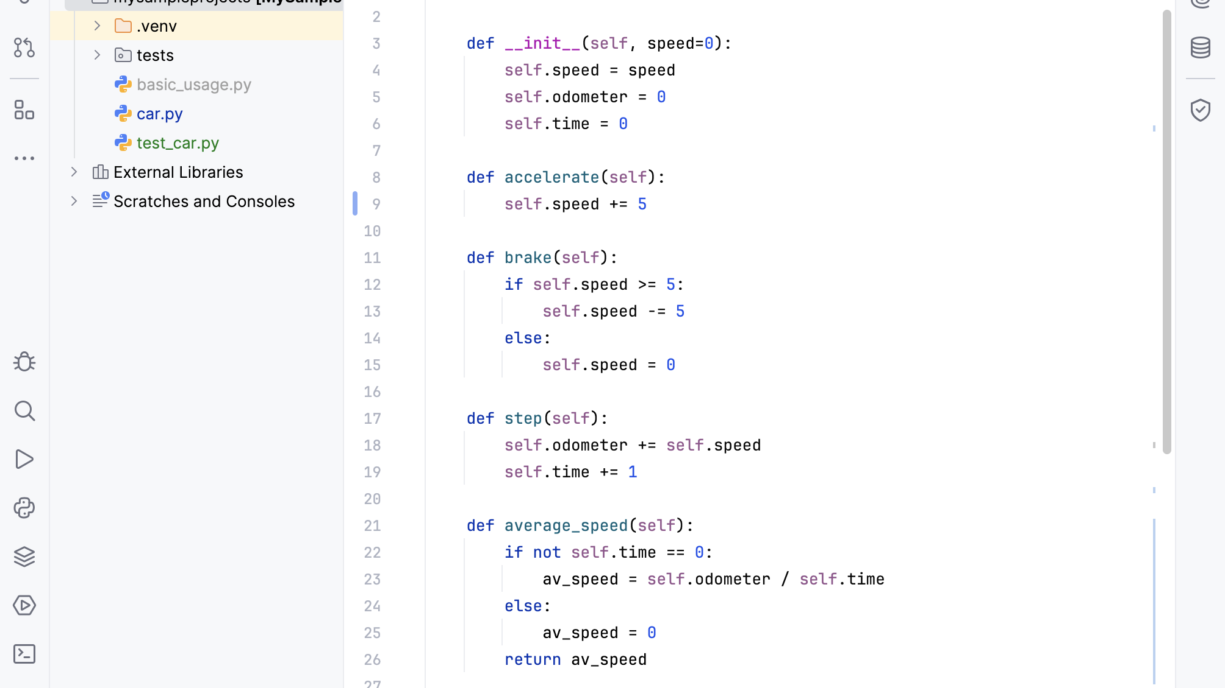
Automation Using Python Selenium
Python Selenium
Implementation Features
Script-Based Automation
Script-based automation in PyCharm provides robust, maintainable, and scalable test automation solutions.
WebDriver Initialization
Automated browser startup and configuration.
IDE: PyCharm Professional
Language: Python 3.x
Binding: Selenium WebDriver
Element Interaction
Click, type, and scroll automation.
Wait Commands
Element Locator Strategies
Implicit and explicit waits for dynamic content.
ID
Name
Validation & Assertions
XPath
CSS Selector
Automated result verification.

Slide 10
Execution Results
Total Test Cases
Passed
Success Rate
7
7
100%
Test Execution Summary
Test Case ID | Test Scenario | Status
TC_HomePageLoad_01 | Verify Amazon homepage loads | Pass
TC_ProductSearch_02 | Verify product search with valid keyword | Pass
TC_InvalidSearch_03 | Verify search with invalid keyword | Pass
TC_CategorySelection_04 | Verify category selection from dropdown | Pass
TC_ProductDetails_05 | Verify product details page opens | Pass
TC_AddToCart_06 | Verify item can be added to cart | Pass
TC_RemoveCart_07 | Verify item can be removed from cart | Pass
All execution logs verified successfully for both Selenium IDE and Python Selenium implementations

Slide 11
Issues Faced & Learning Outcomes
Issues Faced
Learning Outcomes
Several technical challenges were encountered and resolved during the automation implementation.
The project provided valuable hands-on experience and deep understanding of automated testing concepts.
Dynamic Element Locators
Hands-on Experience
Element locators changed frequently especially on Amazon, requiring adaptive locator strategies.
Gained practical experience with Selenium IDE for rapid test automation development.
Functional Testing Concepts
Page Loading Delays
Developed deep understanding of automated functional testing principles and best practices.
Page loading delays required implementation of explicit and implicit wait commands for synchronization.
Importance of Assertions
Pop-ups & Dynamic Banners
Learned the critical role of assertions in automation for reliable test validation.
Pop-ups and dynamic banners interfered with recordings, requiring manual handling in scripts.
Test Case Design Skills
Improved test case design skills through structured manual and automated test development.

Slide 12
Testing Vidoes With
Selenium IDE Extension
Location: Drive Link

Slide 13
TestCase-01
Homepage Load
Location: Drive Link

Slide 14
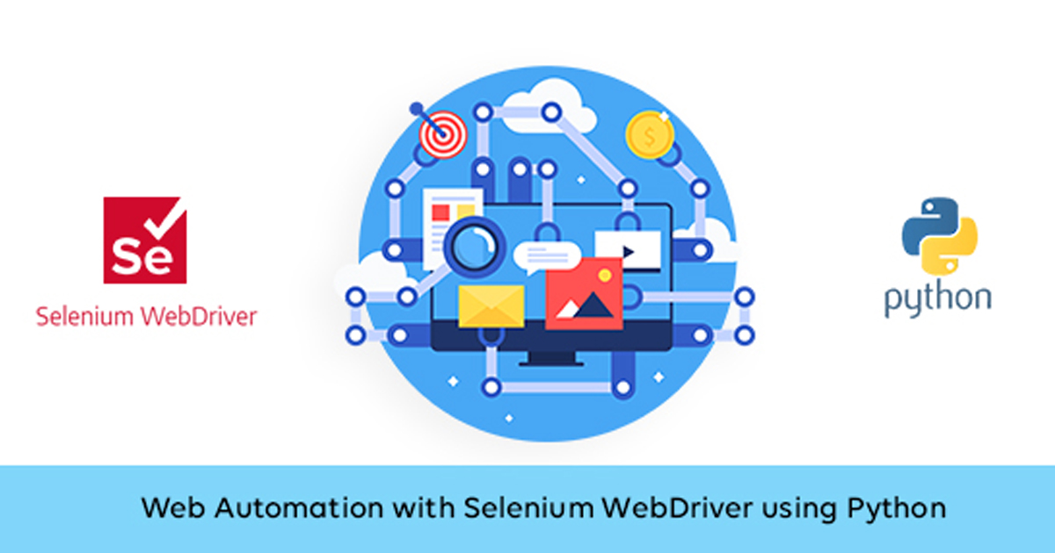
Thank You
Software Quality Engineering Project
Selenium IDE
Python Selenium
Amazon Testing
Record & Playback
Script Automation
7 Test Cases
Team Member
Team Member
M. TALHA FAROOQI
HUSNAIN ASLAM
F2022065010
F2022065361

